Slide 1
UNIT II FEATURE ENGINEERING AND DIMENSIONALITY REDUCTION
Feature Engineering – Feature Transformation – Feature Subset Selection - Principle Component Analysis – Feature Embedding – Factor Analysis – Singular value decomposition and Matrix Factorization – Multidimensional scaling – Linear Discriminant Analysis – Canonical Correlation Analysis – Isomap – Locally linear Embedding – Laplacian Eigenmaps.

Slide 2
What is a feature?
What is feature engineering?
1. feature transformation
1. feature construction
2. feature extraction
2. feature subset selection / Feature Selection
Feature construction
Feature extraction

Slide 3
What is a feature?
A feature is an attribute of a data set that is used in a machine learning process. There is a view amongst certain machine learning practitioners that only those attributes which are meaningful to a machine learning problem are to be called as features.
The features in a data set are also called its dimensions. So a data set having ‘n’ features is called an n-dimensional data set.
It has three key components – feature construction, feature selection, and feature transformation.

Slide 4
What is feature engineering?
Feature engineering refers to the process of translating a data set into features such that these features are able to represent the data set more effectively and result in a better learning performance.
As we know already, feature engineering is an important pre-processing step for machine learning. It has two major elements:
1. feature transformation
2. feature subset selection

Slide 5
Feature transformation transforms the data – structured or unstructured, into a new set of features which can represent the underlying problem which machine learning is trying to solve. There are two variants of feature transformation:
1. feature construction
2. feature extraction
Both are sometimes known as feature discovery.

Slide 6
Feature construction process discovers missing information about the relationships between features and augments the feature space by creating additional features. Hence, if there are ‘n’ features or dimensions in a data set, after feature construction ‘m’ more features or dimensions may get added. So at the end, the data set will become ‘n + m’ dimensional.
Feature extraction is the process of extracting or creating a new set of features from the original set of features using some functional mapping.

Slide 7
FEATURE TRANSFORMATION
Engineering a good feature space is a crucial prerequisite for the success of any machine learning model. However, often it is not clear which feature is more important. For that reason, all available attributes of the data set are used as features and the problem of identifying the important features is left to the learning model. This is definitely not a feasible approach, particularly for certain domains e.g. medical image classification, text categorization, etc

Slide 8
Unlike feature transformation, in case of feature subset selection (or simply feature selection) no new feature is generated.
The objective of feature selection is to derive a subset of features from the full feature set which is most meaningful in the context of a specific machine learning problem. So, essentially the job of feature selection is to derive a subset F_{j} (F₁ , F₂ , …, F_{m} ) of F (F₁, F₂ , …, F_{n} ), where m < n, such that F is most meaningful and gets the best result for a machine learning problem.

Slide 9
Feature transformation is used as an effective tool for dimensionality reduction and hence for boosting learning model performance. Broadly, there are two distinct goals of feature transformation:
Achieving best reconstruction of the original features in the data set
Achieving highest efficiency in the learning task
Using numerical prefixes, n-gram of size 1 is called unigram (i.e. a single word), size 2 is called bigram (i.e. a two-word phrase), size 3 is called trigram (i.e. a three-word phrase) etc.

Slide 10
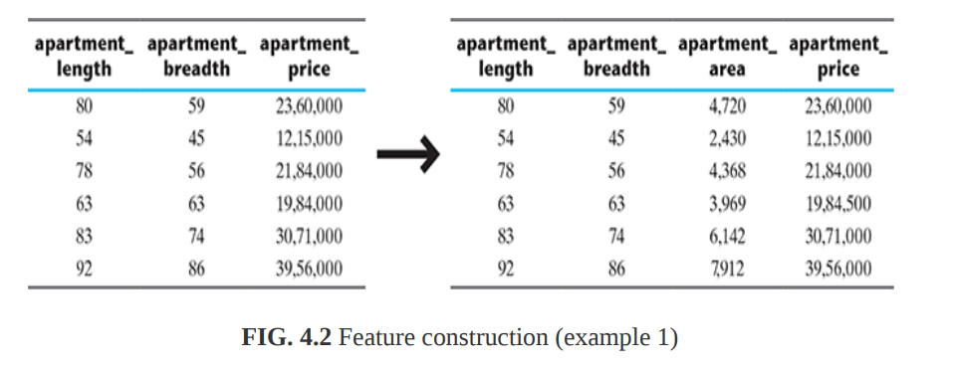
Feature construction
Feature construction involves transforming a given set of input features to generate a new set of more powerful features.

Slide 11
There are certain situations where feature construction is an essential activity before we can start with the machine learning task. These situations are
when features have categorical value and machine learning needs numeric value inputs
when features having numeric (continuous) values and need to be converted to ordinal values
when text-specific feature construction needs to be done

Slide 12
Encoding categorical (nominal) variables
The feature chance of a win is a class variable while the others are predictor variables. We know that any machine learning algorithm, whether it’s a classification algorithm (like kNN) or a regression algorithm, requires numerical figures to learn from.
In this case, feature construction can be used to create new dummy features which are usable by machine learning algorithms.

Slide 13
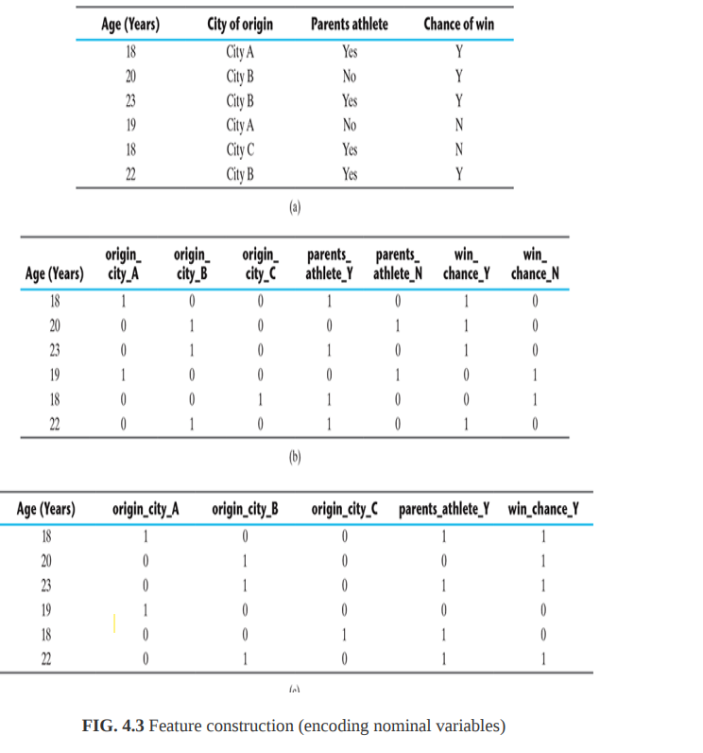

Slide 14
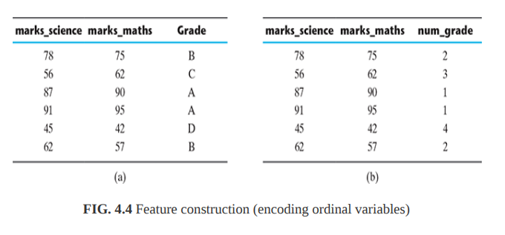
Encoding categorical (ordinal) variables
As we can see, the grade is an ordinal variable with values A, B, C, and D. To transform this variable to a numeric variable, we can create a feature num_grade mapping a numeric value against each ordinal value. In the context of the current example, grades A, B, C, and D in Figure 4.4a is mapped to values 1, 2, 3, and 4 in the transformed variable shown in Figure 4.4b.

Slide 15
Transforming numeric (continuous) features to categorical features
Sometimes there is a need of transforming a continuous numerical variable into a categorical variable. For example, we may want to treat the real estate price prediction problem, which is a regression problem, as a real estate price category prediction, which is a classification problem.

Slide 16
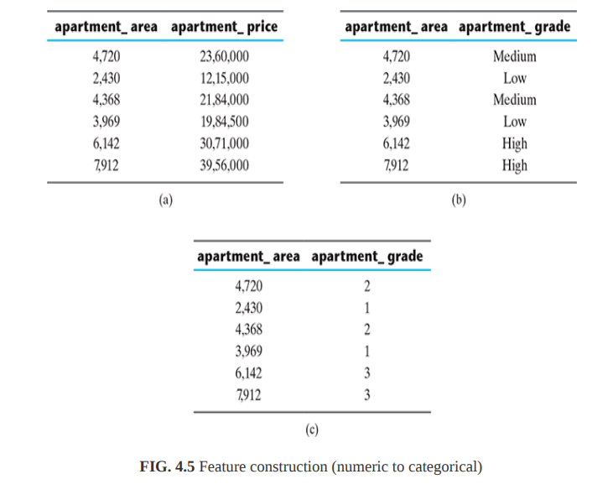

Slide 17
Text-specific feature construction
Text data, or corpus which is the more popular keyword, is converted to a numerical representation following a process is known as vectorization. In this process, word occurrences in all documents belonging to the corpus are consolidated in the form of bag-of-words. There are three major steps that are followed:
1. tokenize
2. count
3. Normalize
In order to tokenize a corpus, the blank spaces and punctuations are used as delimiters to separate out the words, or tokens. Then the number of occurrences of each token is counted, for each document.

Slide 18
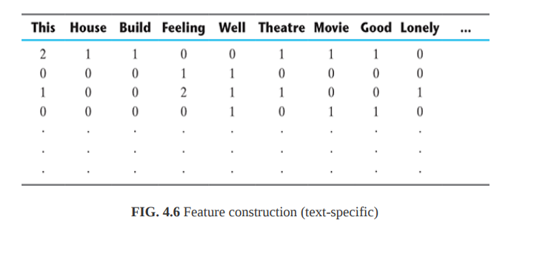

Slide 19
Feature extraction
Some of the commonly used operators for combining the original features include
1. For Boolean features: Conjunctions, Disjunctions, Negation, etc.
2. For nominal features: Cartesian product, M of N, etc.
3. For numerical features: Min, Max, Addition, Subtraction, Multiplication, Division, Average, Equivale
Let’s take an example and try to understand. Say, we have a data set with a feature set F_{i} (F₁ , F₂ , …, F_{n}). After feature extraction using a mapping function f (F₁ , F₂ , …, F_{n}) .

Slide 20
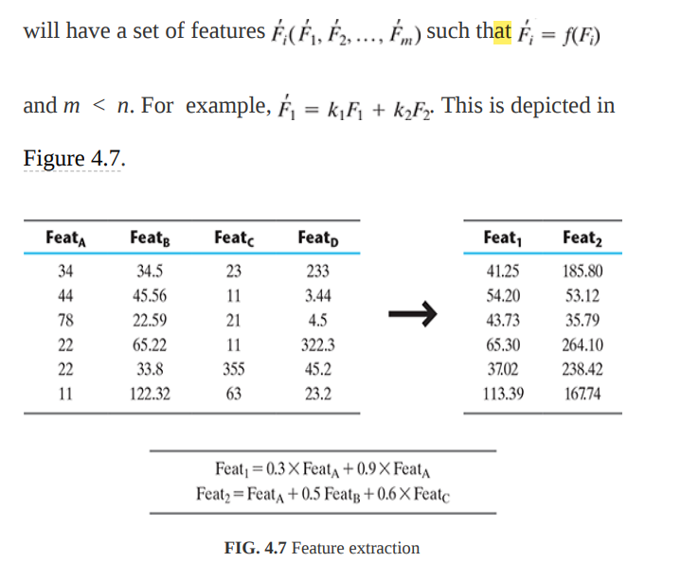

Slide 21

The most popular feature extraction algorithms used in machine learning:
Principal Component Analysis
Singular value decomposition
Linear Discriminant Analysis
Principal Component Analysis
Any vector ‘v’ in a vector space can be represented as
The objective of PCA is to make the transformation in such a way that
1. The new features are distinct, i.e. the covariance between the new features, i.e. the principal components is 0.
2. The principal components are generated in order of the variability in the data that it captures. Hence, the first principal component should capture the maximum variability, the second principal component should capture the next highest variability etc.
3. The sum of variance of the new features or the principal components should be equal to the sum of variance of the original features.

Slide 22
Principal Component Analysis
PCA works based on a process called eigenvalue decomposition of a covariance matrix of a data set.
Below are the steps to be followed:
1. First, calculate the covariance matrix of a data set.
2. Then, calculate the eigenvalues of the covariance matrix.
3. The eigenvector having highest eigenvalue represents the direction in which there is the highest variance. So this will help in identifying the first principal component.
4. The eigenvector having the next highest eigenvalue represents the direction in which data has the highest remaining variance and also orthogonal to the first direction. So this helps in identifying the second principal component.
5. Like this, identify the top ‘k’ eigenvectors having top ‘k’ eigenvalues so as to get the ‘k’ principal components.

Slide 23

Singular value decomposition
Singular value decomposition (SVD) is a matrix factorization technique commonly used in linear algebra. SVD of a matrix A (m × n) is a factorization of the form:
SVD of a data matrix is expected to have the properties highlighted below:
1. Patterns in the attributes are captured by the right-singular vectors, i.e. the columns of V.
2. Patterns among the instances are captured by the left-singular, i.e. the columns of U.
3. Larger a singular value, larger is the part of the matrix A that it accounts for and its associated vectors.
4. New data matrix with ‘k’ attributes is obtained using the equation
Thus, the dimensionality gets reduced to k SVD is often used in the context of text data.

Slide 24


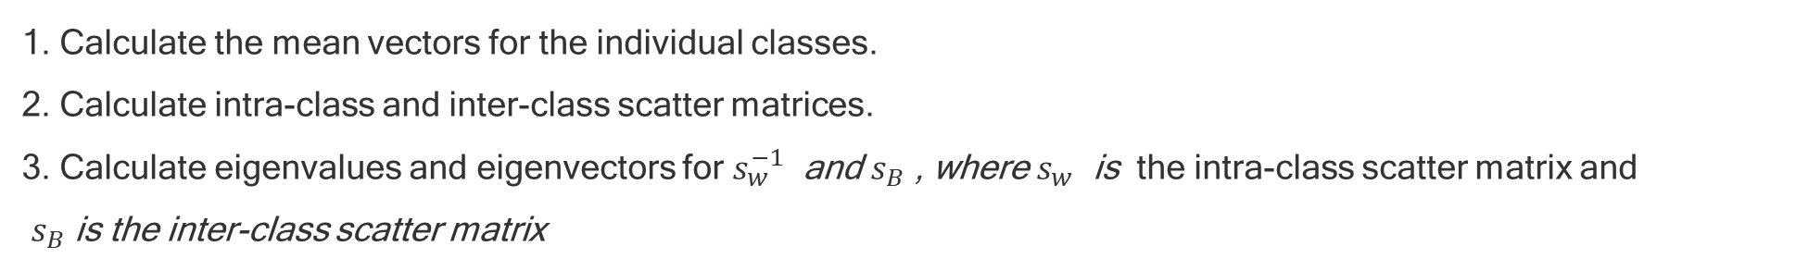
Linear Discriminant Analysis
The objective of LDA is similar to the sense that it intends to transform a data set into a lower dimensional feature space.
LDA focuses on class separability, i.e. separating the features based on class separability so as to avoid over-fitting of the machine learning model.
LDA calculates eigenvalues and eigenvectors within a class and inter-class scatter matrices.
Below are the steps to be followed:
1. Calculate the mean vectors for the individual classes.
2. Calculate intra-class and inter-class scatter matrices.
3. Calculate eigenvalues and eigenvectors for $s_{w}^{−1}$ and $s_{B}$ , where $s_{w}$ is the intra-class scatter matrix and
$s_{B}$ is the inter-class scatter matrix
where, mi is the sample mean for each class, m is the overall mean of the data set, Ni is the sample size of each class
where, m is the mean vector of the i-th class
4. Identify the top ‘k’ eigenvectors having top ‘k’ eigenvalues

Slide 25
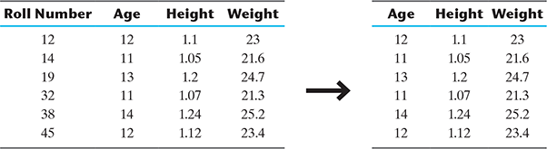
FEATURE SUBSET SELECTION

Slide 26
1.Issues in high-dimensional data
‘High-dimensional’ refers to the high number of variables or attributes or features present in certain data sets, more so in the domains like DNA analysis, geographic information systems (GIS), social networking, etc. The high-dimensional spaces often have hundreds or thousands of dimensions or attributes, e.g. DNA microarray data can have up to 450,000 variables (gene probes).
The objective of feature selection is three-fold:
Having faster and more cost-effective (i.e. less need for computational resources) learning model
Improving the efficiency of the learning model
Having a better understanding of the underlying model that generated the data

Slide 27
2.Key drivers of feature selection – feature relevance and redundancy
2.1Feature relevance
In supervised learning, the input data set which is the training data set, has a class label attached. A model is inducted based on the training data set – so that the inducted model can assign class labels to new, unlabelled data. Each of the predictor variables, is expected to contribute information to decide the value of the class label. In case a variable is not contributing any information, it is said to be irrelevant. In case the information contribution for prediction is very little, the variable is said to be weakly relevant. Remaining variables, which make a significant contribution to the prediction task are said to be strongly relevant variables

Slide 28
In unsupervised learning, there is no training data set or labelled data. Grouping of similar data instances are done and similarity of data instances are evaluated based on the value of different variables. Certain variables do not contribute any useful information for deciding the similarity of dissimilarity of data instances. Hence, those variables make no significant information contribution in the grouping process. These variables are marked as irrelevant variables in the context of the unsupervised machine learning task.

Slide 29
Any feature which is irrelevant in the context of a machine learning task is a candidate for rejection when we are selecting a subset of features. We can consider whether the weakly relevant features are to be rejected or not on a case-to-case basis.

Slide 30
2.2Feature redundancy
when one feature is similar to another feature, the feature is said to be potentially redundant in the context of the learning problem.
All features having potential redundancy are candidates for rejection in the final feature subset. Only a small number of representative features out of a set of potentially redundant features are considered for being a part of the final feature subset.
So, in a nutshell, the main objective of feature selection is to remove all features which are irrelevant and take a representative subset of the features which are potentially redundant. This leads to a meaningful feature subset in context of a specific learning task.

Slide 31
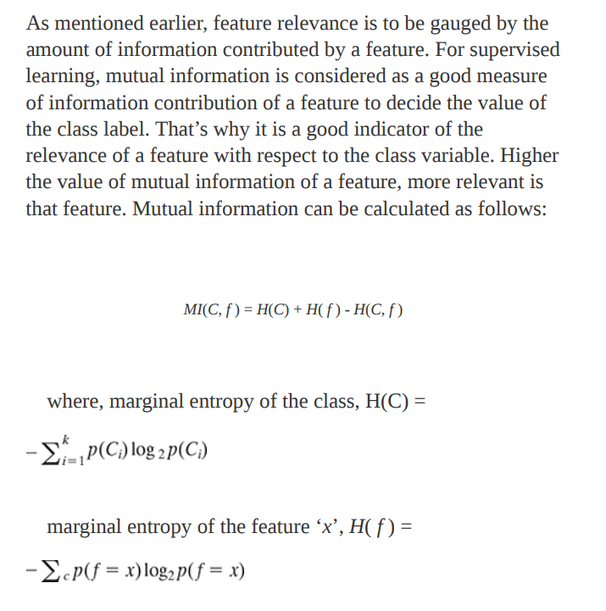
Measures of feature relevance and redundancy
Measures of feature relevance
and K = number of classes, C = class variable, f = feature set that take discrete values.

Slide 32
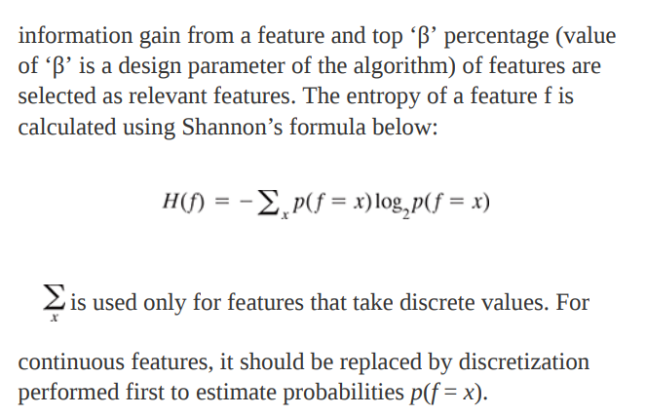
In case of unsupervised learning, there is no class variable. Hence, feature-to-class mutual information cannot be used to measure the information contribution of the features. In case of unsupervised learning, the entropy of the set of features without one feature at a time is calculated for all the features. Then, the features are ranked in a descending order of

Slide 33
3.Measures of Feature redundancy
Feature redundancy, as we have already discussed, is based on similar information contribution by multiple features. There are multiple measures of similarity of information contribution, salient ones being
1. Correlation-based measures
2. Distance-based measures, and
3. Other coefficient-based measure

Slide 34
1. Correlation-based similarity measure
Correlation is a measure of linear dependency between two random variables. Pearson’s product moment correlation coefficient is one of the most popular and accepted measures of correlation between two random variables. For two random feature variables F and F , Pearson correlation coefficient is defined as:

Slide 35
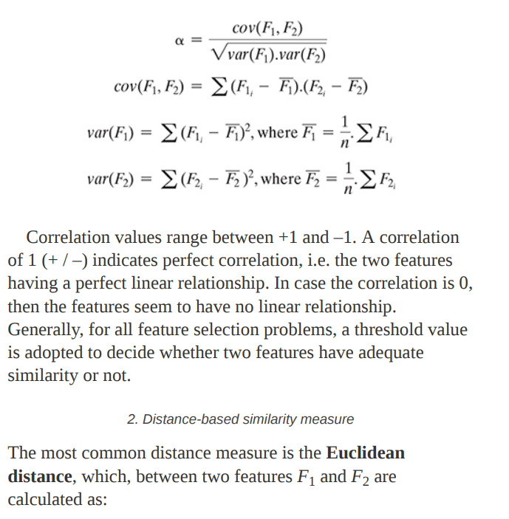

Slide 36
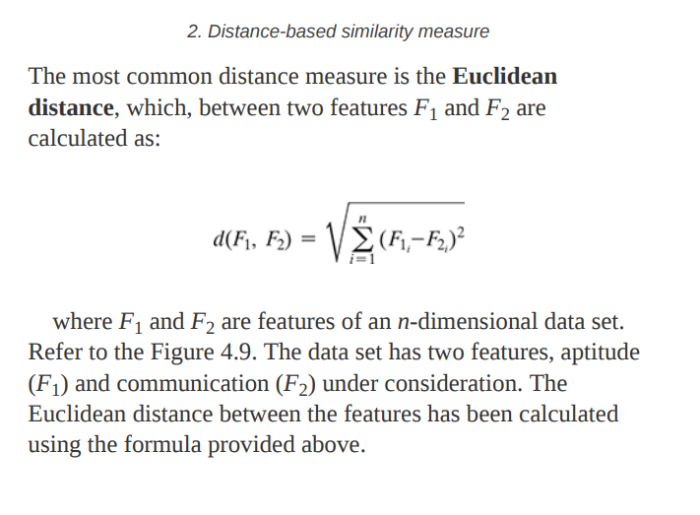

Slide 37
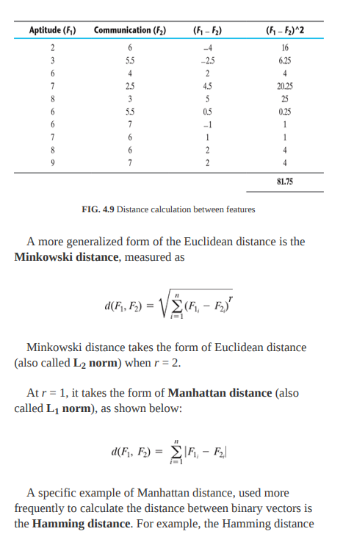

Slide 38
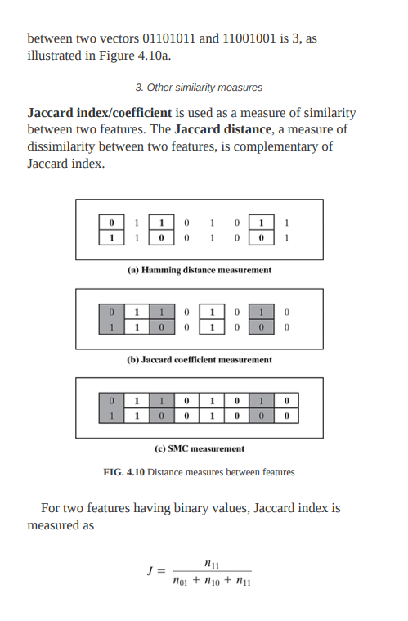

Slide 39
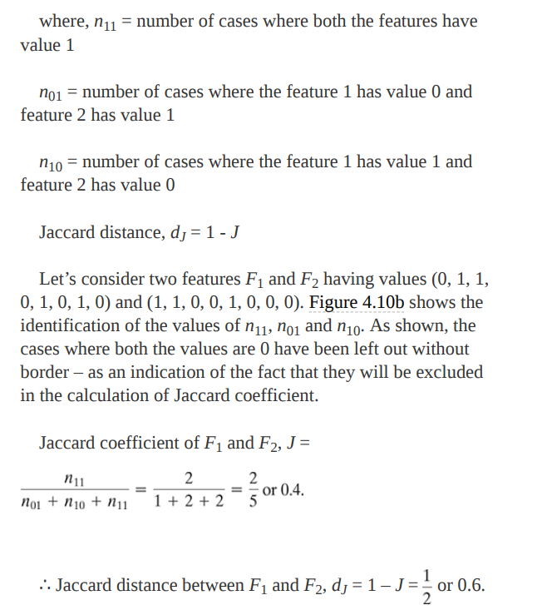

Slide 40
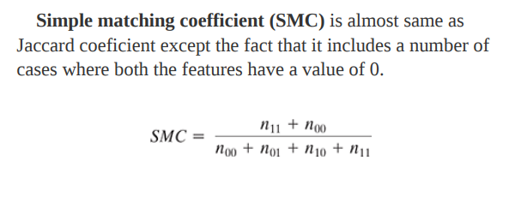
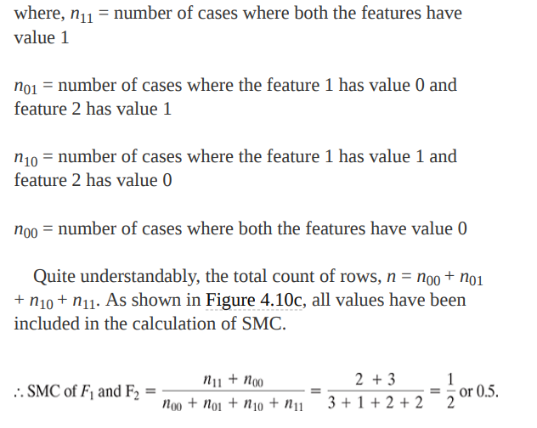

Slide 41
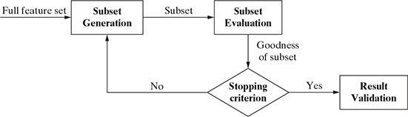
Overall feature selection process
consists of four steps:
1. generation of possible subsets
2. subset evaluation
3. stop searching based on some stopping criterion
4. validation of the result
Some commonly used stopping criteria are
1. the search completes
2. some given bound (e.g. a specified number of iterations) is reached
3. subsequent addition (or deletion) of the feature is not producing a better subset
4. a sufficiently good subset (e.g. a subset having better classification accuracy than the existing benchmark) is selected
1. sequential forward selection
2. Sequential backward elimination.
3. bi-directional selection.

Slide 42
Overall feature selection process
There are four types of approach for feature selection:
1. Filter approach
2. Wrapper approach
3. Hybrid approach
4. Embedded approach
Some of the common statistical tests conducted on features as a part of filter approach are –
Pearson’s correlation, information gain, Fisher score, analysis of variance (ANOVA), Chi-Square, etc.

Slide 43
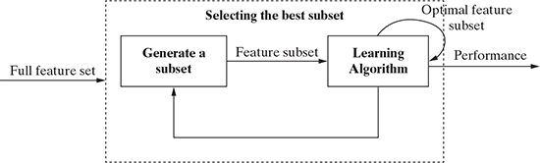
wrapper approach
Identification of best feature subset is done using the induction algorithm as a black box.
Hybrid approach
both filter and wrapper approaches

Slide 44
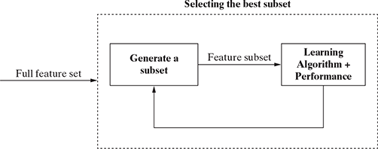
Embedded approach
It performs feature selection and classification simultaneously.

